Slide 1
Unit No 4: Tableau for Data Preparation and Advanced Visualization

Slide 2
Introduction to Tableau: Tableau Desktop and Tableau Server, Connecting to various data sources, Understanding Tableau workspace and terminology. Data Preparation and Transformation in Tableau: Data connections and joins, Data blending and data reshaping. Working with metadata and calculations, Tableau data extracts. Creating Visualizations and Dashboards in Tableau: Building basic charts and graphs, Interactive filters and parameters, advanced visualization techniques, Dashboard design best practices.

Slide 3
Tableau Desktop and Tableau Server
What is a Tableau Desktop?
Tableau Desktop, largely used for business intelligence is a data visualization software that transforms huge amount of data (mostly statistical data) into interactive visual representations, such as graphs and charts.
What is a Tableau Server?
A Tableau Desktop provides the ability to create interactive workbooks and dashboards, the Tableau server allows the users to publish, share and administrate this Tableau Desktop content.

Slide 4
A Tableau Server has an administrator who controls over the access to server content (that is, Tableau Desktop content published in the Tableau Server) to help protect sensitive data.
A Tableau Server administrator can set user permissions on projects, workbooks, views, and data sources.

Slide 5
Tableau Desktop Vs Tableau Server
Tableau Desktop | Tableau Server
Tableau Desktop can be used to create worksheets, dashboards, stories connecting to data sources which can be files or server | Tableau Server can be used to publish the worksheet, dashboard and stories that are created using Tableau Desktop
One can share their work locally by sending the workbook (twbx). But it is important to know that the recipient should have Tableau Desktop or Tableau Reader in their PC | Once the workbook is uploaded onto the server, the recipient need not have Tableau Server installed in their PC. All that they need is Login credentials.
Tableau desktop is best use for developers to build in reports to give insights to decision makers | Tableau server best fits Decision makers to analyze their results.
Tableau Desktop- Development | Tableau Server- Sharing and Collaboration

Slide 6
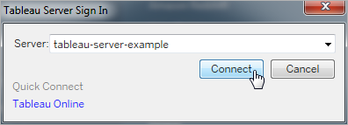
Connect to Data by Using Tableau Server or Tableau Cloud
You can connect to data from either Tableau Desktop or a web browser by using Tableau Server or Tableau Cloud.
Start Tableau Desktop and on the Connect pane, under Search for Data, select Tableau Server.
To connect to Tableau Server, enter the name of the server and then select Connect.To connect to Tableau Cloud, select Tableau Cloud under Quick Connect.

Slide 7
3. To sign in:
For Tableau Server, enter your user name and password.
For Tableau Cloud, enter your email address and password.
4. Select data to connect to. The Search for Data dialog displays scrollable list of mixed content that's popular.
If you have a Data Management license, you can connect to data with a virtual connection.
if you have Data Management with Tableau Catalog enabled, you can also connect to external assets, like databases, files, and tables.
5. The responsive search field shows a list of suggestions that updates as you enter text.
Filter search results by type of data, certification status, or other filters that depend on the type of data selected.

Slide 8
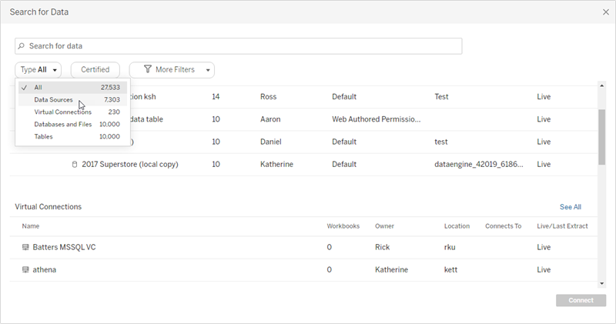
For example, some types of data may allow you to filter based on tags, connection type, data quality warnings, or other criteria. Older versions of the dialog look and function slightly differently, but the overall function is similar.

Slide 9
Note:
Data that you don't have Connect permissions for is unavailable (gray).
External assets (databases, files, and tables) are unavailable (gray) until Catalog finishes ingesting them.
If you select a cube (multidimensional) data source, the Create Local Copy dialog box appears, and you must create a local copy of the data before you can start your analysis.
In Web Authoring, you can make a connection with a subset of the data connectors that Tableau Desktop supports. If a data source, database, file, or table is grayed out, you can't connect from Tableau Server or Tableau Cloud. You can, however, connect from the Tableau Desktop Connect pane, if you have the correct permissions.
6. After you select the data you want to connect to, click Connect.
7. Select the sheet tab to start your analysis.

Slide 10
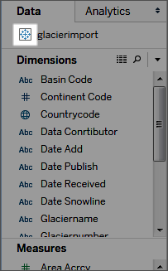
Data sources published to Tableau Server or Tableau Cloud are shown in the Data pane with a Tableau icon.
You might want to download a local copy of the data source so that you can, for example, work offline or make changes to a data source without modifying the original.
To download a local copy, on the Data menu, select the data source, and then select Create Local Copy. A duplicate of the data source is added to the Data pane.

Slide 11
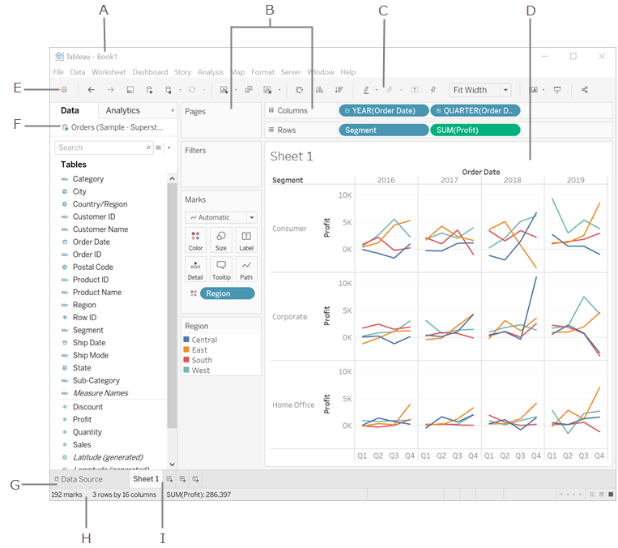
Understanding Tableau workspace and terminology

Slide 12
A. Workbook name. A workbook contains sheets. A sheet can be a worksheet, a dashboard, or a story. For more information, see Workbooks and Sheets.
B. Cards and shelves - Drag fields to the cards and shelves in the workspace to add data to your view.
C. Toolbar - Use the toolbar to access commands and analysis and navigation tools.
D. View - This is the canvas in the workspace where you create a visualization (also referred to as a "viz").
E. Click this icon to go to the Start page, where you can connect to data. For more information, see Start Page.
F. Side Bar - In a worksheet, the side bar area contains the Data pane and the Analytics pane.
G. Click this tab to go to the Data Source page and view your data. For more information, see Data Source Page.
H. Status bar - Displays information about the current view.
I. Sheet tabs - Tabs represent each sheet in your workbook. This can include worksheets, dashboards, and stories. For more information, see Workbooks and Sheets.

Slide 13
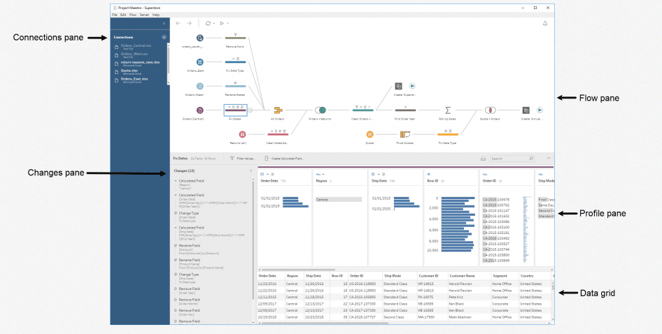
Data Preparation and Transformation in Tableau
Tableau Prep is a data preparation tool designed for analysts and business users who try to prepare data for themselves.
but might get stuck because they don’t have traditional ETL expertise.
The tool empowers users to combine, shape, and cleanse data for analysis in Tableau.

Slide 14
Tableau Prep has a clean and friendly user interface. The look feels like the final form of Tableau Desktop’s data source screen. Above is a screen shot view of a Superstore “flow” in Tableau Prep. There are a few key panes in the screen to be aware of:
Connections pane: Shows the databases and files you are connected to. Add connections to one or more databases and then drag the tables you want to work with into the flow pane.
Flow pane: As you clean, shape, and combine your data, steps will appear in the flows. This visual indication will allow the user to see an overview of their changes. The user can accomplish a variety of data cleaning tasks in moments, such as fuzzy clustering and other smart features.
Profile pane: Displays a summary of each field in your data and allows users to see the shape of their data and begin to identify any issues with their data.

Slide 15
d) Changes pane: Tableau Prep keeps track of the changes you make, in the order you make them, so you can always go back and review or edit those changes.
e) Data grid: Lets the user see row level detail and verify individual records.

Slide 16
Cleaning Your Data
To create a Flow and begin to clean our data, we need to connect to a data source.
Tableau supports a wide variety of on-premise and cloud-based data sources.
We’ll connect to three text files and create a Flow.

Slide 17
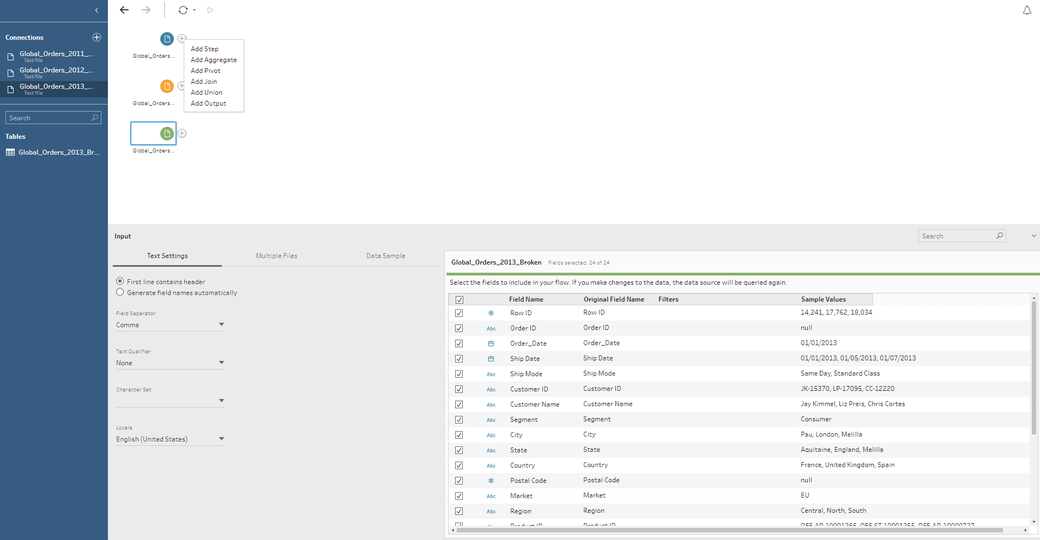

Slide 18
Introduction to Tableau Metadata API
The Tableau Metadata API discovers and indexes all of the content on your Tableau Cloud site or Tableau Server, including workbooks, data sources, flows, and metrics.
Indexing is used to gather information about Tableau content, or metadata, about the schema and lineage of the content.
Then from the metadata, Metadata API identifies all of the databases, files, and tables used by the content on your Tableau Cloud site or Tableau Server.

Slide 19
You can do the following tasks using the Metadata API:
Discover data that’s associated with the content published to your Tableau Cloud site or your Tableau Server. Search for external assets like tables, databases, and data sources.
Track lineage or the relationships between content and external assets, like data sources and workbooks. For example, identify which workbooks use a specific published data source.
Perform impact analysis. Using upstream and downstream lineage information, you can evaluate impact of changes to content. For example, find all worksheets that depend on a database table column or identify the authors you should notify when a data source change occurs.

Slide 20
Tableau metadata?
The Metadata API discovers, tracks, stores, and then surfaces information about Tableau content.
The content can be categorized by type (e.g., table or workbook). The content can be unique to Tableau (e.g., embedded data sources and calculated fields) and its external assets not unique to Tableau (e.g., database tables and columns).
Both content and external assets can have information attached to them (e.g., tags and ratings).
Both content and external assets can also have relationships to other content and external assets.
The relationships among the content and external assets and the information about each is the metadata.

Slide 21
Use of Calculated Fields
Calculated fields allow you to create new data from data that already exists in your data source.
When you create a calculated field, you are essentially creating a new field (or column) in your data source, the values or members of which are determined by a calculation that you control.
This new calculated field is saved to your data source in Tableau, and can be used to create more robust visualizations.
You can use calculated fields for many, many reasons. Some examples might include:
To segment data
To convert the data type of a field, such as converting a string to a date.
To aggregate data
To filter results
To calculate ratios

Slide 22
Types of calculations
There are three main types of calculations you can use to create calculated fields in Tableau:
Basic calculations - Basic calculations allow you to transform values or members at the data source level of detail (a row-level calculation) or at the visualization level of detail (an aggregate calculation).
Level of Detail (LOD) expressions - Just like basic calculations, LOD calculations allow you to compute values at the data source level and the visualization level.
However, LOD calculations give you even more control on the level of granularity you want to compute.
They can be performed at a more granular level (INCLUDE), a less granular level (EXCLUDE), or an entirely independent level (FIXED) with respect to the granularity of the visualization.
Table calculations - Table calculations allow you to transform values at the level of detail of the visualization only.
The type of calculation you choose depends on the needs of your analysis and the question you want to answer.

Slide 23
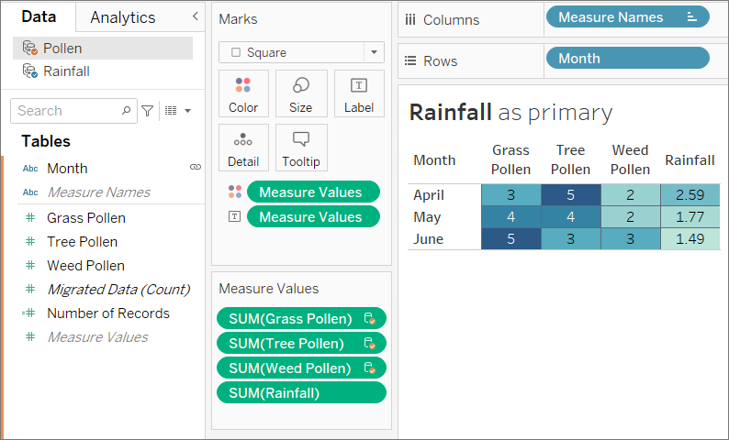
Data blending and data reshaping
Data blending is a method for combining data.
Data blending works by supplementing the data in the primary data source with the data in the secondary data source.

Slide 24
Data Blending
What is Data Blending in Tableau?
Data Blending in Tableau is an approach to combine data from multiple varieties of sources and display them as a whole on one single screen.
For example, consider a scenario where a business analyst needs to work with sales data. Now, let us imagine, the customer data is stored at the Oracle Database, and the order details are stored in a SQL Server.
In such situations, the procedure of Data Blending comes in handy. Business analysts can combine the data from Oracle Database and SQL Server, treat it as a whole and extract business insights.

Slide 25
Interactive filters and parameters
Filters in form can have multi-select values while parameters are single select base on a list or require user input.
Actions are available for parameters but not for filters. Parameter actions enable changes in your view, by hover, select or menu.

Slide 26
What are the Parameters in Tableau?
The parameters in Tableau are the workbook variables like a number, date, or calculated field that allows users to replace a constant value in a calculation, filter, or reference line.
For example, the user can create a new calculated field that returns True if the aggregate of total marks is greater than 90% and returns False if it is less than 90%.
Users can replace the constant value of "90%" in the formula with the parameters in Tableau as per the requirements.
With the parameter control, users can dynamically vary the threshold values in their calculation.

Slide 27
How to Create Parameters in Tableau?
There are multiple possibilities of creating the Parameters in Tableau based on the user's requirements.
Top N Parameters in Tableau
Date Field Parameters in Tableau
Dynamic Measures
Dynamic Dimensions

Slide 28
Dynamic Measures
Dynamic measures are often used in Tableau in cases where we want to visualize a certain size depending on other measures.
For example, we can analyze product categories according to sales, profit or other measures that interest us.
In order not to build every time another graph or dashboard in which to visualize the dimensions according to several measures, we can use dynamic measures built with the help of a parameter.

Slide 29
When we talk about dynamic measures with multiple number formats, we actually refer to dynamic measures, but each of them being displayed with its own format.
It also offers even more interactivity to end users because they have the option to view data based on percentage, decimal or other values.
For example, profit value can be displayed as a percentage, while the sales value as a decimal.
Thus, depending on our selection and the choice of the measure we want to correlate with a certain dimension in our analysis, the number format or value will be different.
Using dynamic measures with multiple number formats provides more context for analysis and dashboard

Slide 30
Data connections and joins
It is often necessary to combine data from multiple places—different tables or even data sources—to perform a desired analysis.
Depending on the structure of the data and the needs of the analysis, there are several ways to combine the tables.
Relationships vs Joins
The default method in Tableau Desktop is to use relationships.
Relationships preserve the original tables’ level of detail when combining information.
Relationships also allow for context-based joins to be performed on a sheet-by-sheet basis, making each data source more flexible.
Relationships are the recommended method of combining data in most instances.
However, there may be times when you want to directly establish a join, either for control or for desired aspects of a join compared to a relationship, such as deliberate filtering or duplication.

Slide 31
Advanced visualization techniques
Working with advanced data visualization search for ways to present data to their audience by incorporating techniques such as animation, auto focus, multiple dimension views, and other interactive techniques.
When a two-dimensional display cannot fully capture the meaning and context of data, advanced data visualization makes it possible to clearly depict complicated information in a way that is simple yet engaging.
1. Segmentation and Cohort Analytics
2. Advanced Graphs
3. Sophisticated Calculations and Statistical Functions
4. Time Series and Predictive Analysis
5. What-If Analytics

Slide 32
1. Segmentation and Cohort Analytics
Every business needs to understand its target audience very clearly. Segmenting your audience helps you to improve your marketing strategy and pull more earnings for every penny spent. A few of the questions segmentation will answer for you include:
Who are your customers?
What do they buy?
What are their requirements?
Where do they gather?
Cohort analysis in Tableau helps you with the segmentation. A cohort refers to a group of people having similar characteristics.
It allows you to view all the data in one place and categorize it based on different factors using cohort analysis.
Segmentation can also be done using automated clustering, which is an unsupervised machine-learning technique.
Tableau allows you to use clustering to segment large data, especially when there are lots of variables.

Slide 33
2. Advanced Graphs
Apart from the traditional line charts, bar graphs, etc., Tableau allows you to visualize data sets using several advanced graphs:
Motion Chart: A motion chart uses the x-axis and the y-axis to represent the change in variables over time. The changes are marked by the movement of data points, and variation in the colours of data lines.
Bump Chart: A bump chart is an advanced form of a line plot. It allows you to explore the ranks of different variables by comparing their positions. In short, it can be used to identify the popularity of products.
Donut Chart: You can understand a doughnut chart as a pie chart with a hole in between. These charts are used to show the proportions of categorised data.

Slide 34
Waterfall Chart: A waterfall chart helps you visualise positive and negative growth. You can use them to see changes in measures over the year.
Pareto Chart: These are a combination of bar and line graphs. The chart presents the values in descending order and determines the most significant problems and risk management.

Slide 35
Motion Chart
Step 1: Add Dimension Field in Column Section
To begin with, we need a dimension field to add in our Columns section.
From our sample dataset of electronics store sales, we select a dimension field Order Date.
Then we set our field value type to Month.

Slide 36
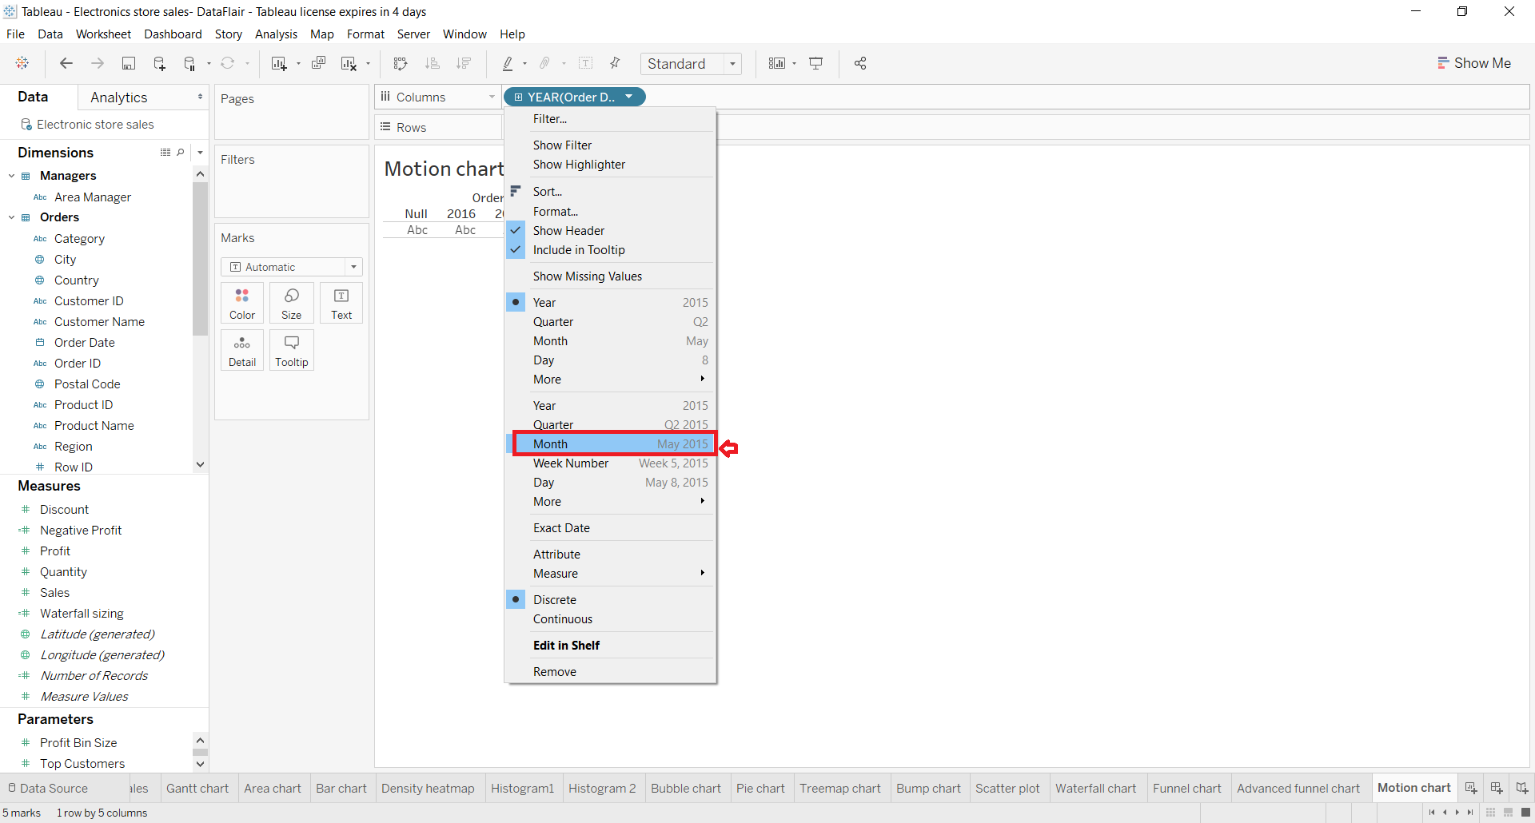

Slide 37
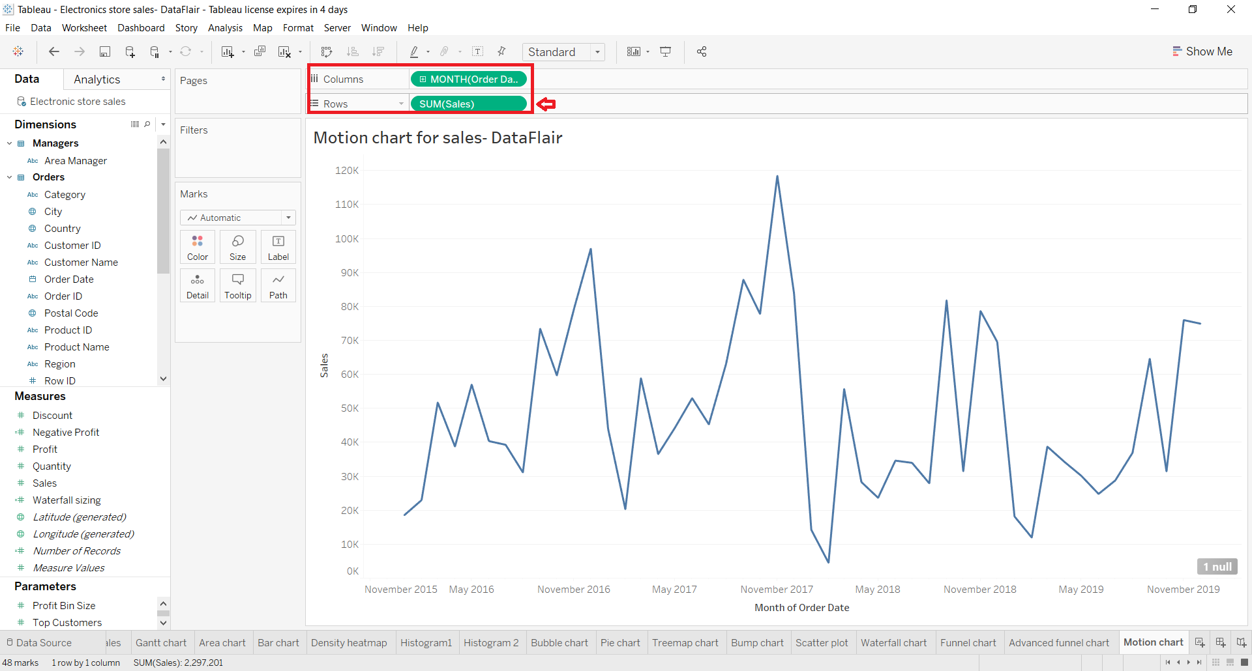
Step 2: Add Measure Field in Rows Section
Next, we add a measure field, Sales in the Rows section.
As you can see, this creates a preliminary line chart on the screen.

Slide 38
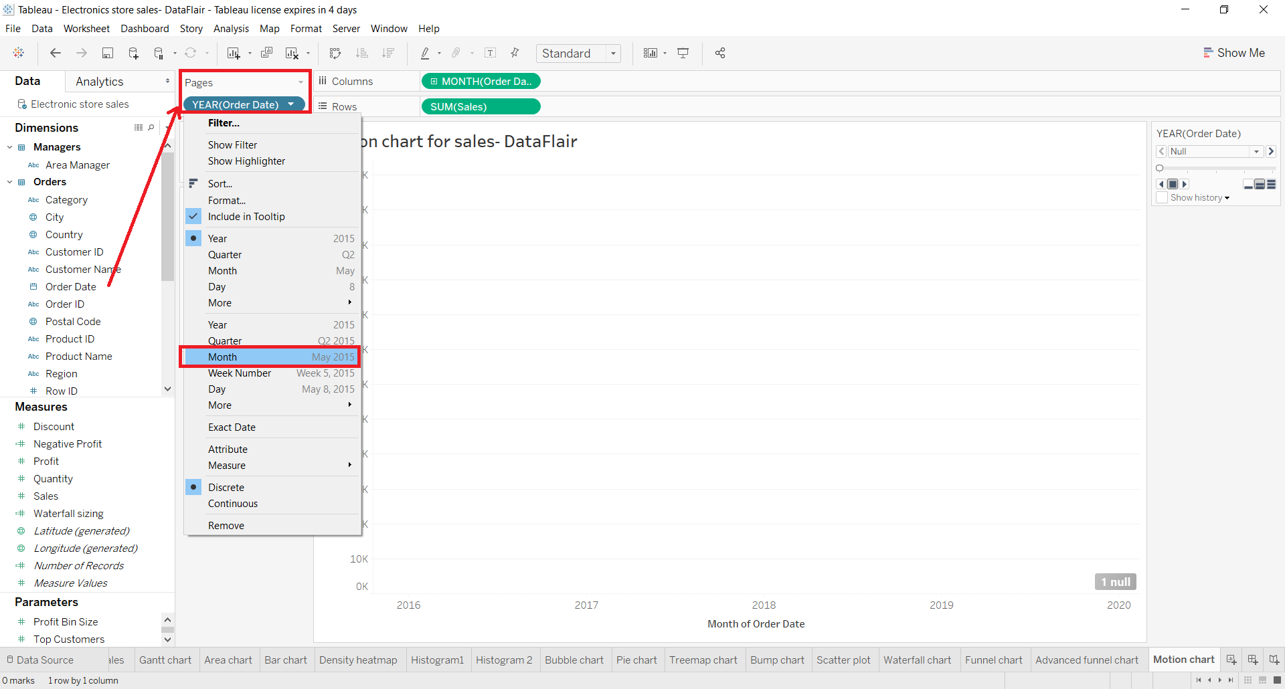
Step 3: Add Dimension Field into Page Section
Here, we add our dimension field, Order Date into the Pages section as shown in the screenshot below.
We change the field value type of this dimension as Month also.

Slide 39
Step 4: Operate Motion Chart with Tableau Play-Pause Button
As soon as we add our dimension to the Pages section, a filter and play box appears on the right.
From here, we can set a range of months or use the tableau play-pause button to operate the motion chart.
In the next steps, we will learn to further use this filter-play box for our motion chart.

Slide 40
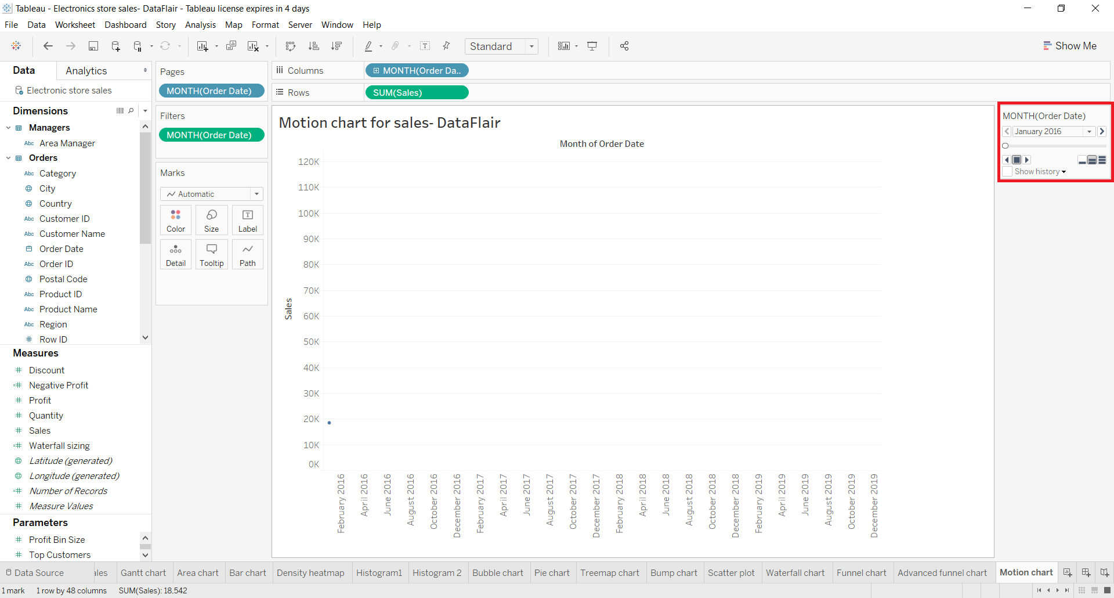

Slide 41
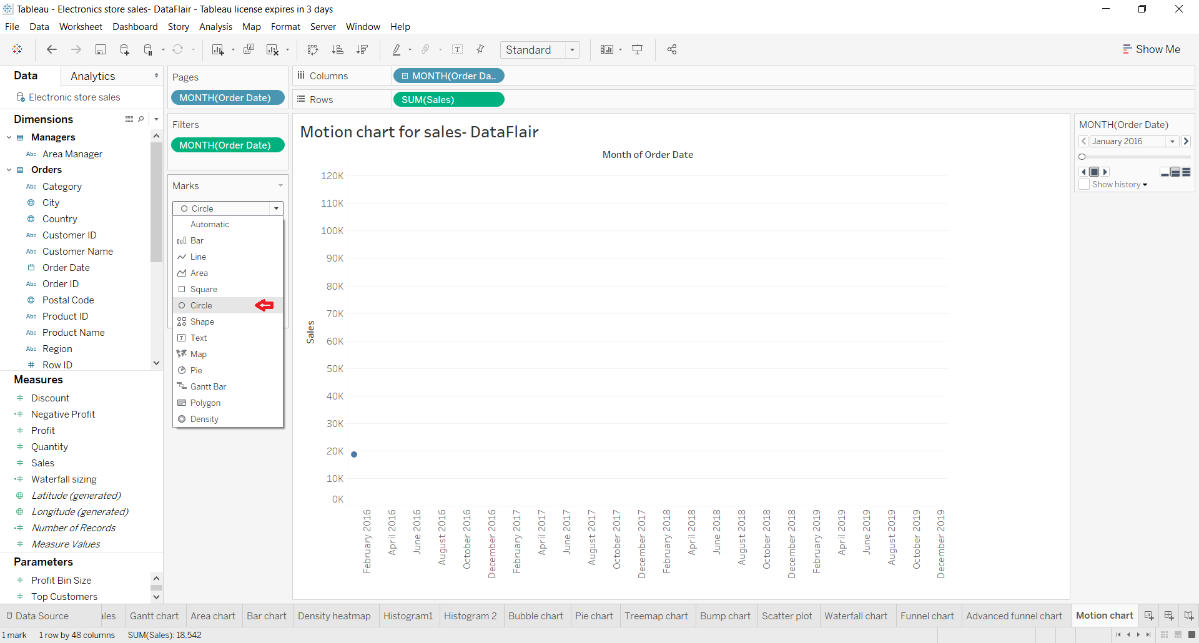
Step 5: Select Circle from the Marks List
Now, we select Circle as the mark type from the Marks list.
This will show individual data points on the plot.

Slide 42
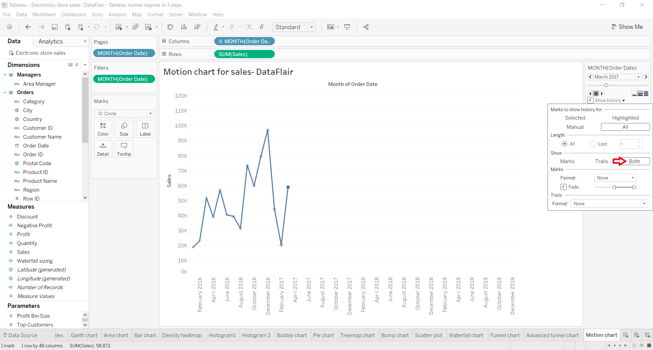
Step 6: Select Both Option in Tableau Motion Chart
We select the option Both so that our motion chart has both data points and trailing line when it moves from a start point to an endpoint.

Slide 43
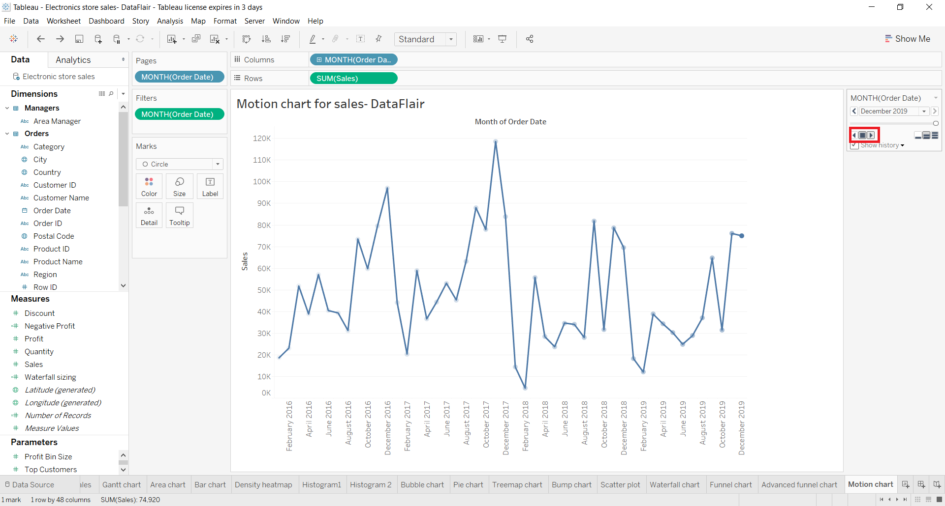
Step 7: Click on Tableau Play Button
Now, clicking on the play button as shown in the screenshot below, motion chart starts from one point moves towards the right following the trail of every data point and then finally terminates on the last data point on the plot.

Slide 44
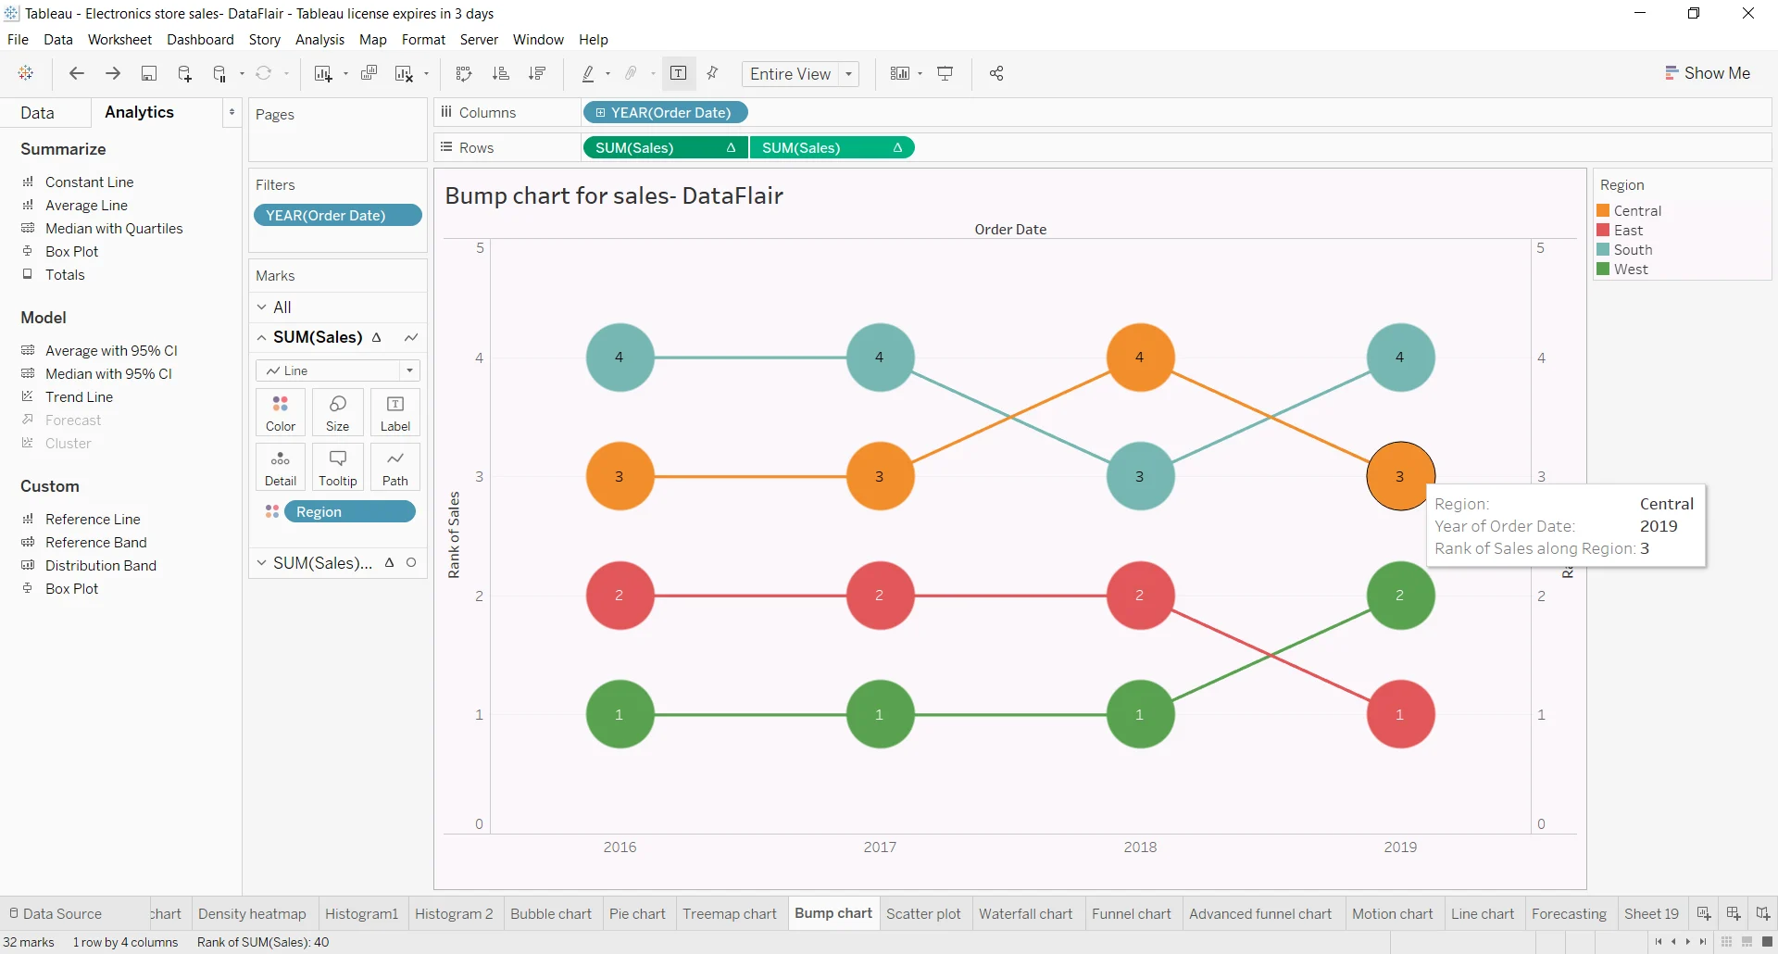
Bump Chart

Slide 45
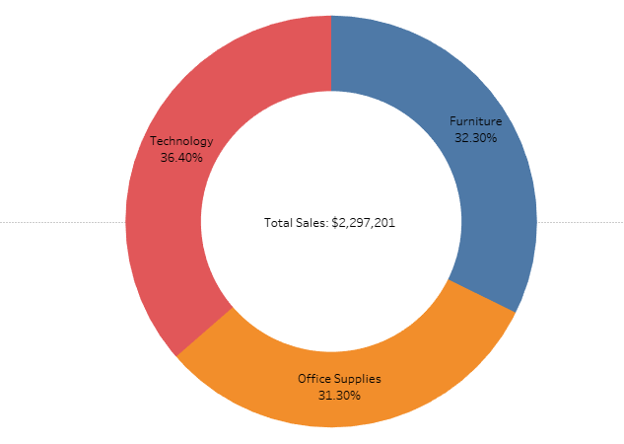
Donut Chart

Slide 46
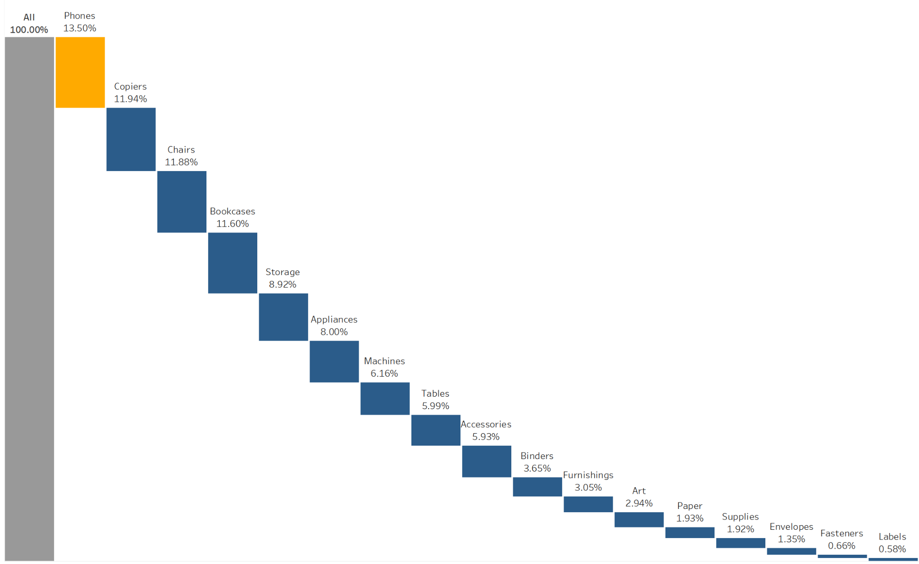
Waterfall Chart

Slide 47
3. Sophisticated Calculations and Statistical Functions
Tableau also allows you to implement statistical methods, such as Correlation, Skewness, Covariance, Mode, Kurtosis, Standard Deviation, etc.
Kurtosis is a measure of the tailedness of a distribution. Tailedness is how often outliers occur.
Excess kurtosis is the tailedness of a distribution relative to a normal distribution.
Distributions with medium kurtosis (medium tails) are mesokurtic.
Distributions with low kurtosis (thin tails) are platykurtic.
Moreover, you can use statistical models like K-Means, Naive Bayes, Random Forest, etc., to understand data and make predictions.
These features in Tableau help you solve complex calculations with ease.
The calculation fields (LOD and table calculations) also allow you to develop new data points from the existing data.

Slide 48
4. Time Series and Predictive Analysis
Time series analysis helps identify seasonal trends, i.e., how certain variables change over time.
Tableau provides a simple interface for time series analysis that helps you understand trends and patterns in data.
With this, you can understand the data better and make predictions.

Slide 49
5. What-If Analytics
The flexible user interface of Tableau has seamless input capabilities.
It helps in making calculations and determining different scenarios.
You can see how the output gets affected by changing input parameters.
The ‘parameters’ feature allows you to change the initial conditions and helps in scenario analysis.
The ‘story points’ feature allows you to define your scenarios.

Slide 50
Dashboard design best practices
The best visualizations have a clear purpose and work for their intended audience.
In addition to knowing what you're trying to say, it's important to know who you're saying it to.
Does your audience know this subject matter extremely well or will it be new to them?
What kind of cues will they need? Thinking about these questions before you head into the design phase can help you create a successful dashboard.

Slide 51
Leverage the most-viewed spot
Most viewers scan web content starting at the top left of a web page.
Once you know your dashboard's main purpose, be sure to place your most important view so that it occupies or spans the upper-left corner of your dashboard.
In the dashboard below, the author decided that the map view holds the key message.

Slide 52
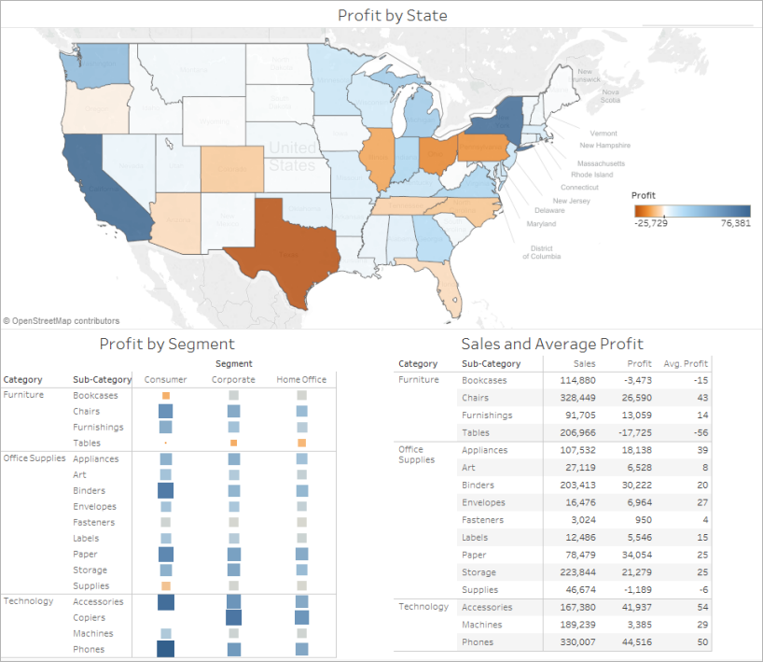

Slide 53
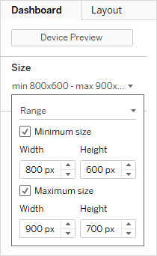
By default, Tableau dashboards are set to use a fixed size and if you keep this setting, be sure to construct your visualization at the size it will be viewed at.
You can also set Size to Automatic, which makes Tableau automatically adapt the overall dimensions of a visualization based on screen size.
This means that if you design a dashboard at 1300 x 700 pixels, Tableau will resize it for smaller displays—and sometimes this results in scrunched views or scrollbars.
The Range sizing feature is helpful for avoiding this.

Slide 54
Limit the number of views
In general, it's a good idea to limit the number of views you include in your dashboard to two or three.
If you add too many views, visual clarity and the big picture can get lost in the details.
If you find that the scope of your story needs to grow beyond two or three views, you can always create more dashboards.

Slide 55
Show filters
Filters help users specify which data is shown in the view.
To turn on filters for a field:
In Tableau Desktop—Right-click the field in the Data window and select Show Filter.
In Tableau Server or Tableau Cloud—In the toolbar click Show/Hide Cards > Filters.
You can customize each filter for different types of data. For example, you can show filters as multi-select check boxes, single select radio buttons, or drop-down lists, etc.
You can include a search button, the option to show all fields, null controls, and more.
You can also edit the title of a filter to give your viewers clear instructions for interacting with the data.

Slide 56
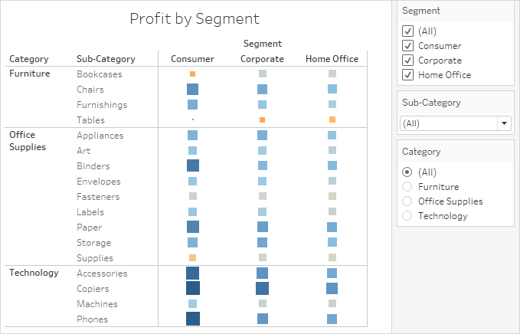

Slide 57
Enable highlighting
You can use the Highlight button on the toolbar to set up highlighting between views.
When highlighting is turned on, a selection in one view will highlight related data in the other views. You can turn on highlighting for all fields or select specific fields.
You can also display a highlighter that allows your customers to highlight parts of a view based on what they enter or select.
To display a highlighter:
Go to the worksheet where the view is (or select Go to Sheet from the dashboard).
Right-click the field you want to highlight—it must be a discrete field—and choose Show Highlighter:

Slide 58
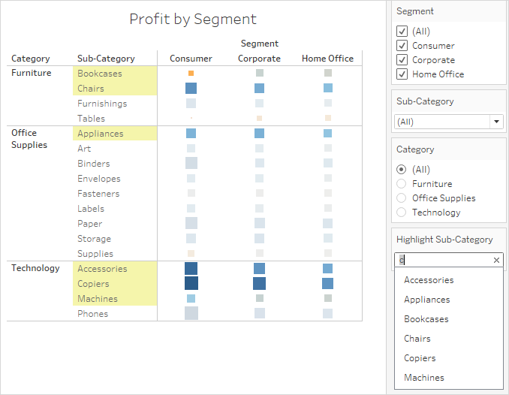
In the highlighter, your users will be able to select or enter terms to highlight data in the view:

Slide 59
Assignment No. 4
Explain Tableau workspace and terminology.
Describe Data Preparation and Transformation in Tableau.
Elaborate Advanced visualization techniques.
Explain in brief Data blending and data reshaping.
Describe any 7 charts and graphs which is used in Tableau for visualization.
Explain in briefly the Tableau Metadata API.
What are the basic steps for creating a dashboards in Tableau.
Note - ( Add examples, Use Graphs n charts where it requires)

